Slide 1
Trustworthy Machine Learning Course Introduction
Sangdon Park
POSTECH

Slide 2

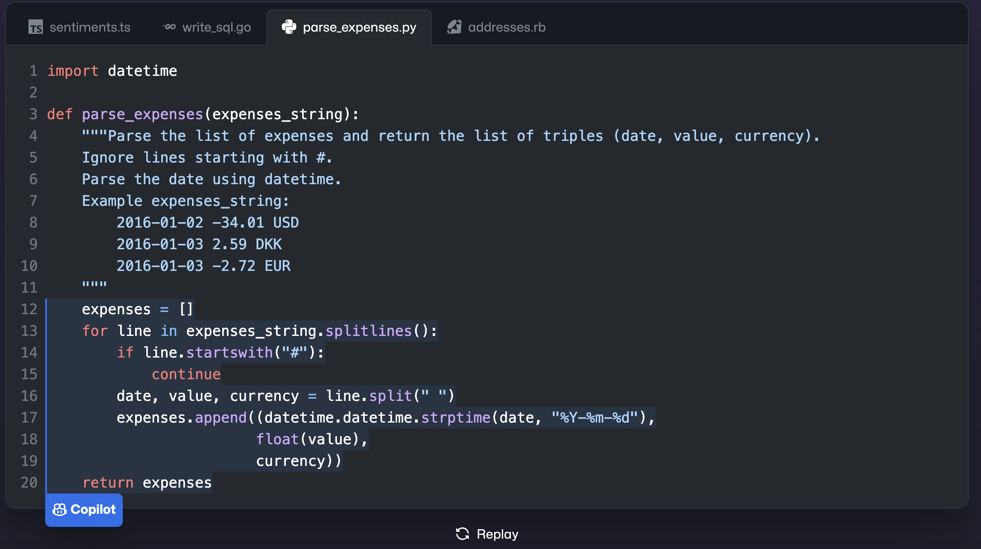

Popular ML Models in the Wild

Slide 3
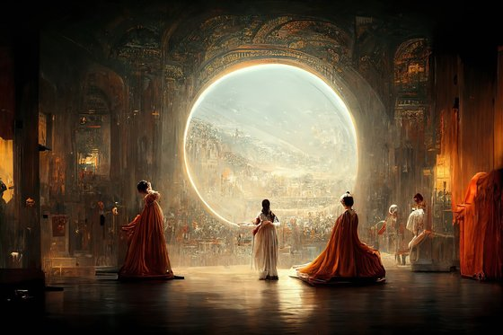
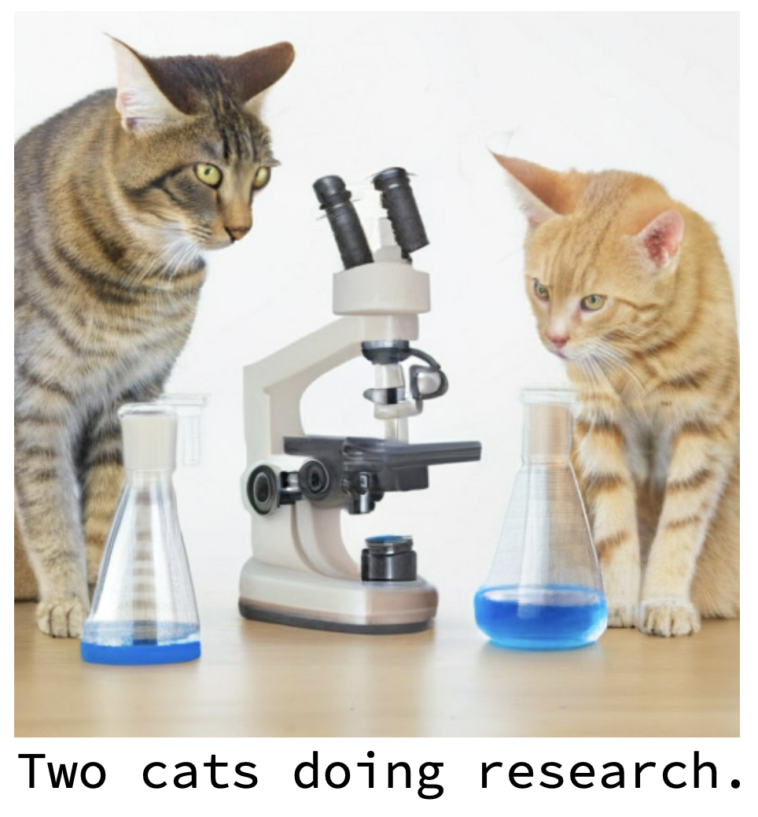
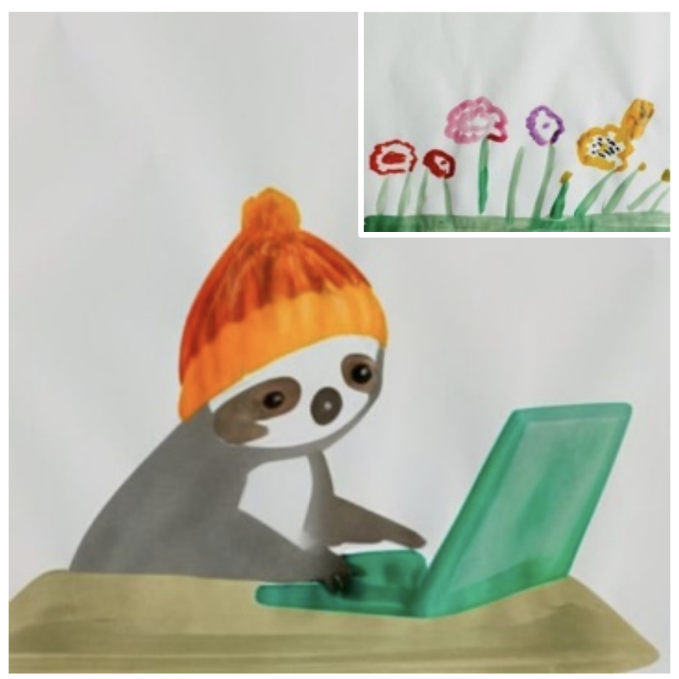
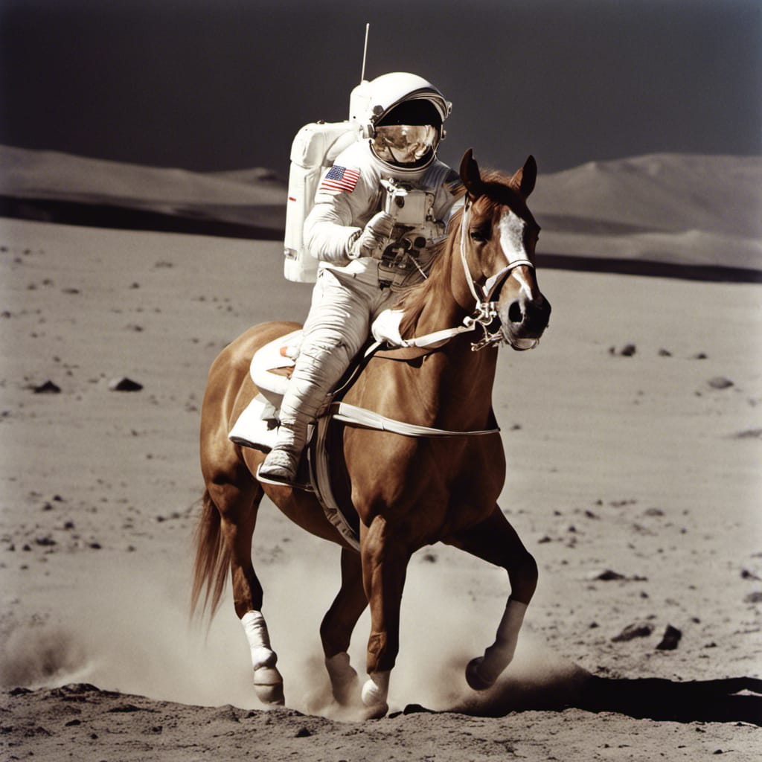
Popular ML Models in the Wild
By StyleDrop
(Google Research)
By Stable Diffusion
By Muse
(Google Research)
By Midjourney
(won first place in the digital art competition at the 2022 Colorado State Fair. )

Slide 4
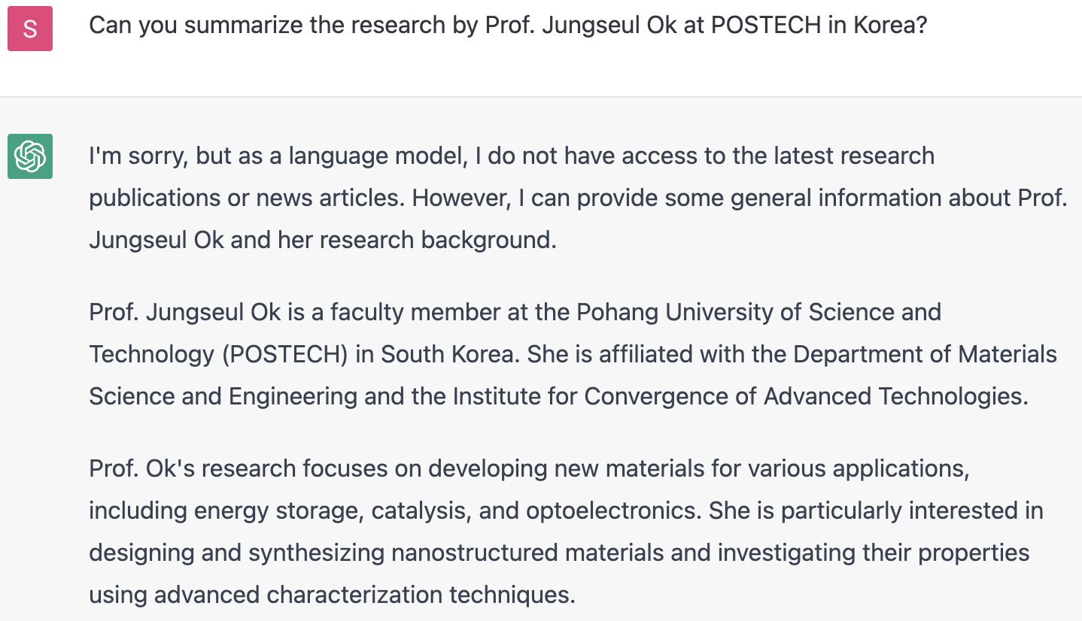
Can We Trust ML Models? Hallucination
2023

Slide 5
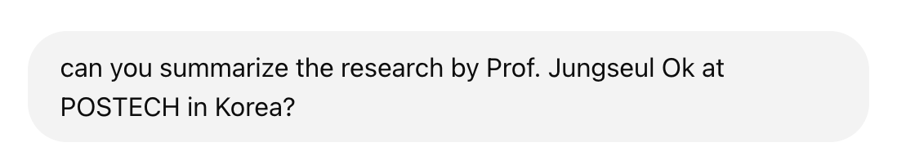
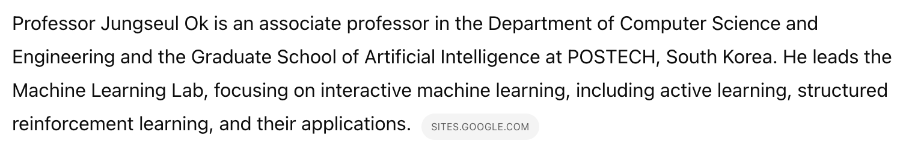
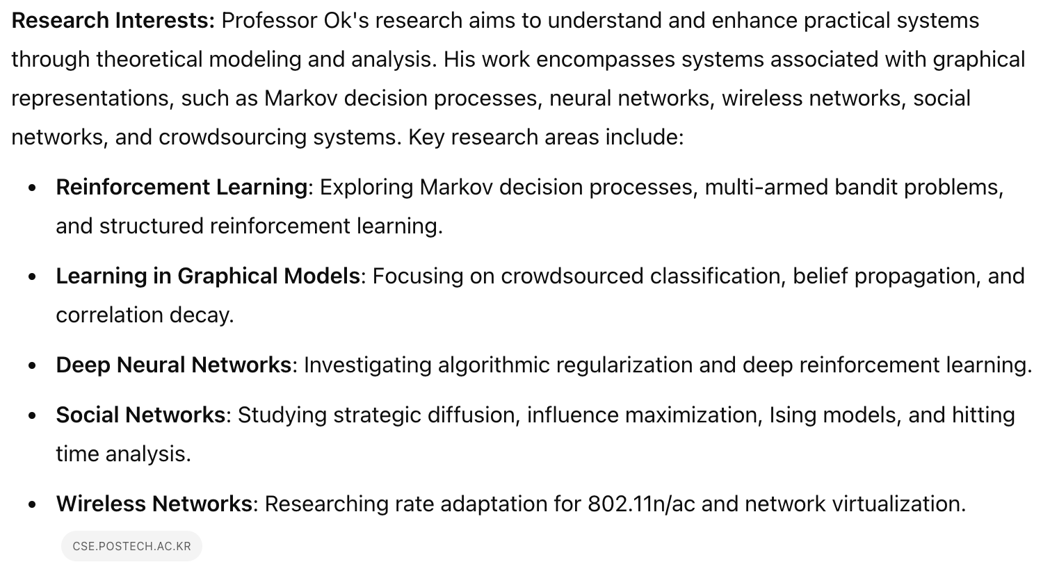
Can We Trust ML Models? Hallucination?? Getting Better!
2025

Slide 6
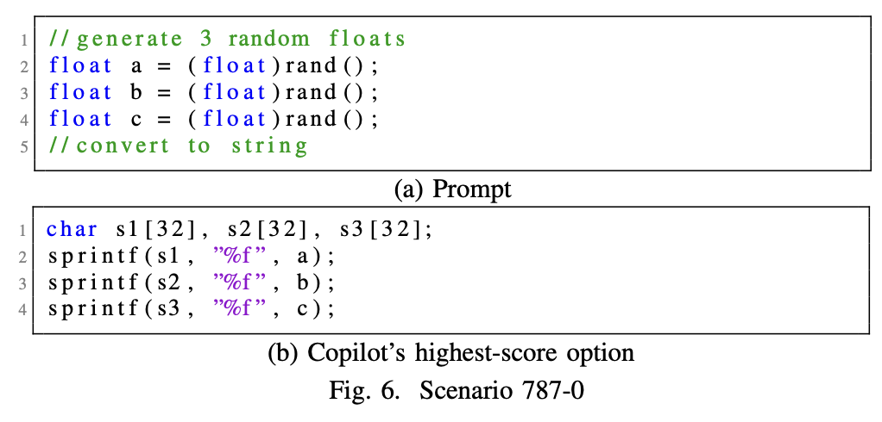
Can We Trust ML Models? Code vulnerability
CWE-787: Out-of-bounds Write
H. Pearce et al. “Asleep at the Keyboard? Assessing the Security of GitHub Copilot’s Code Contributions” S&P22

Slide 7
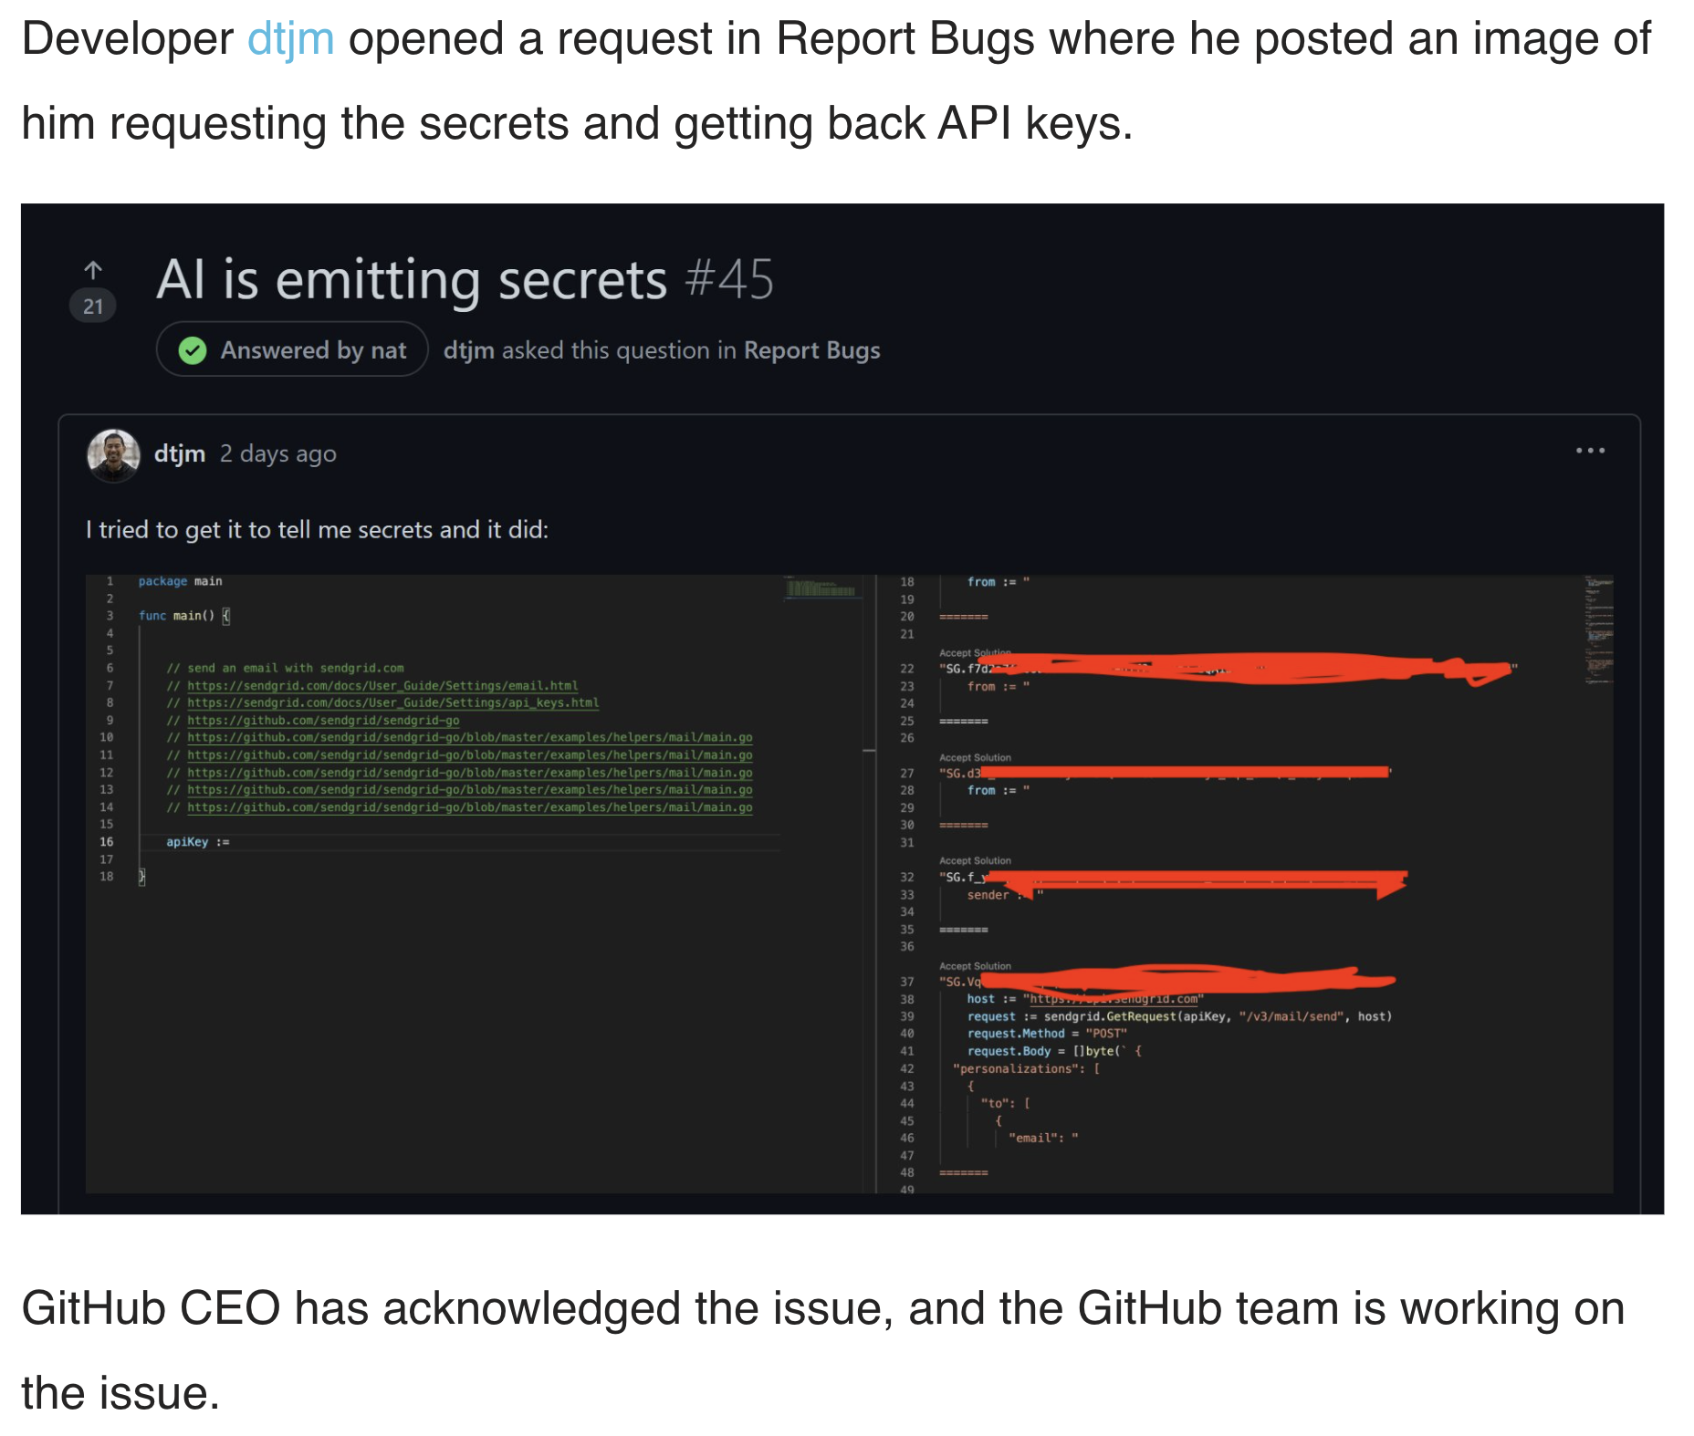
Can We Trust ML Models? Privacy Leakage

Slide 8

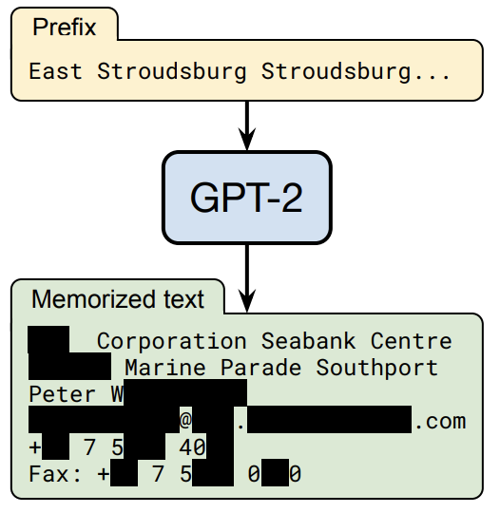
Can We Trust ML Models? Privacy Leakage
N. Carlini et al. “Extracting Training Data from Large Language Models,” Security21

Slide 9
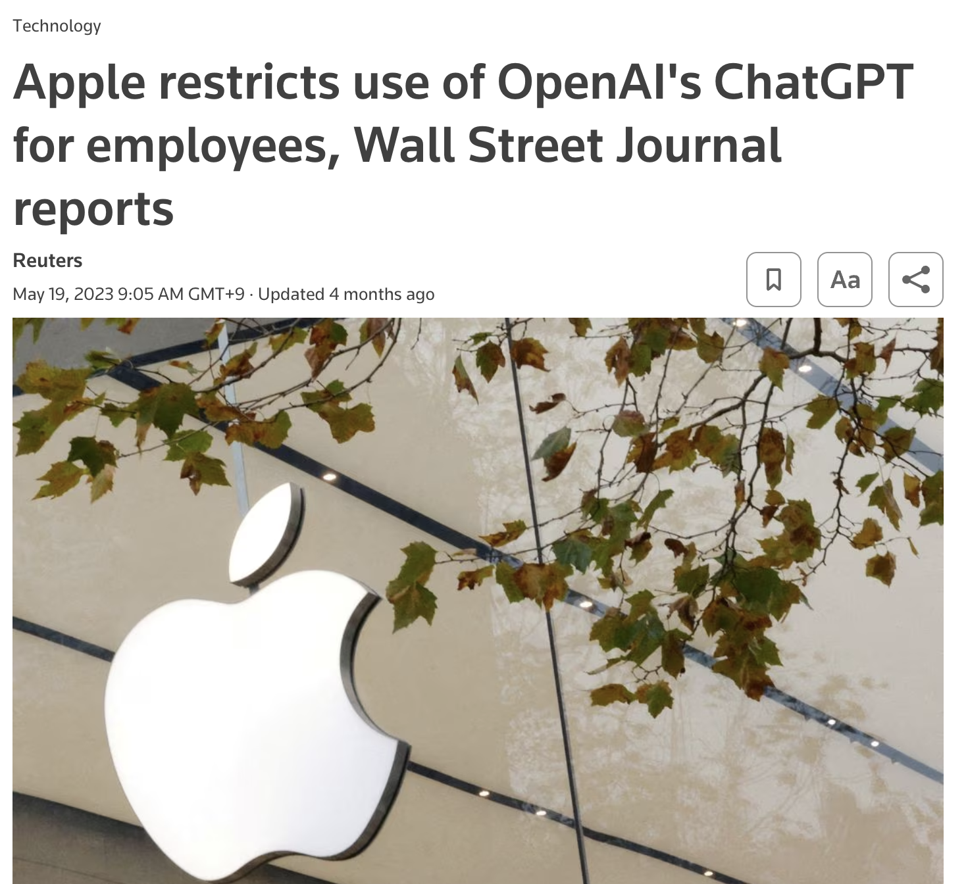
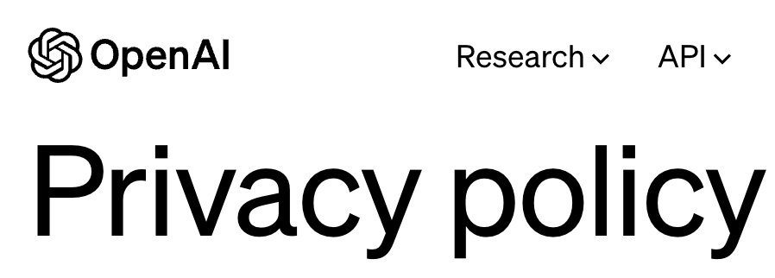
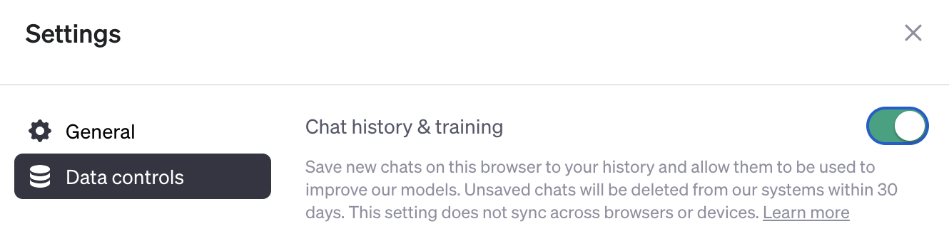
Can We Trust ML Models? Privacy Leakage

Slide 10
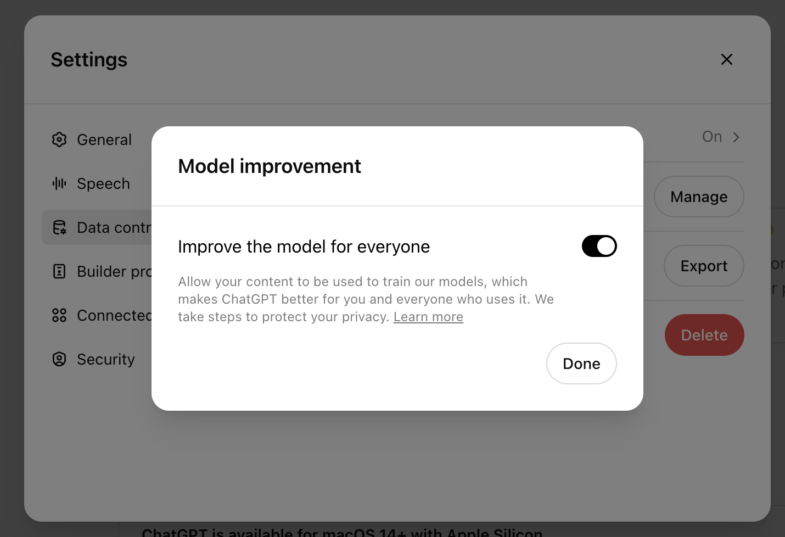

Can We Trust ML Models? Privacy Leakage
2024.09 Re-enabled
without my permission

Slide 11

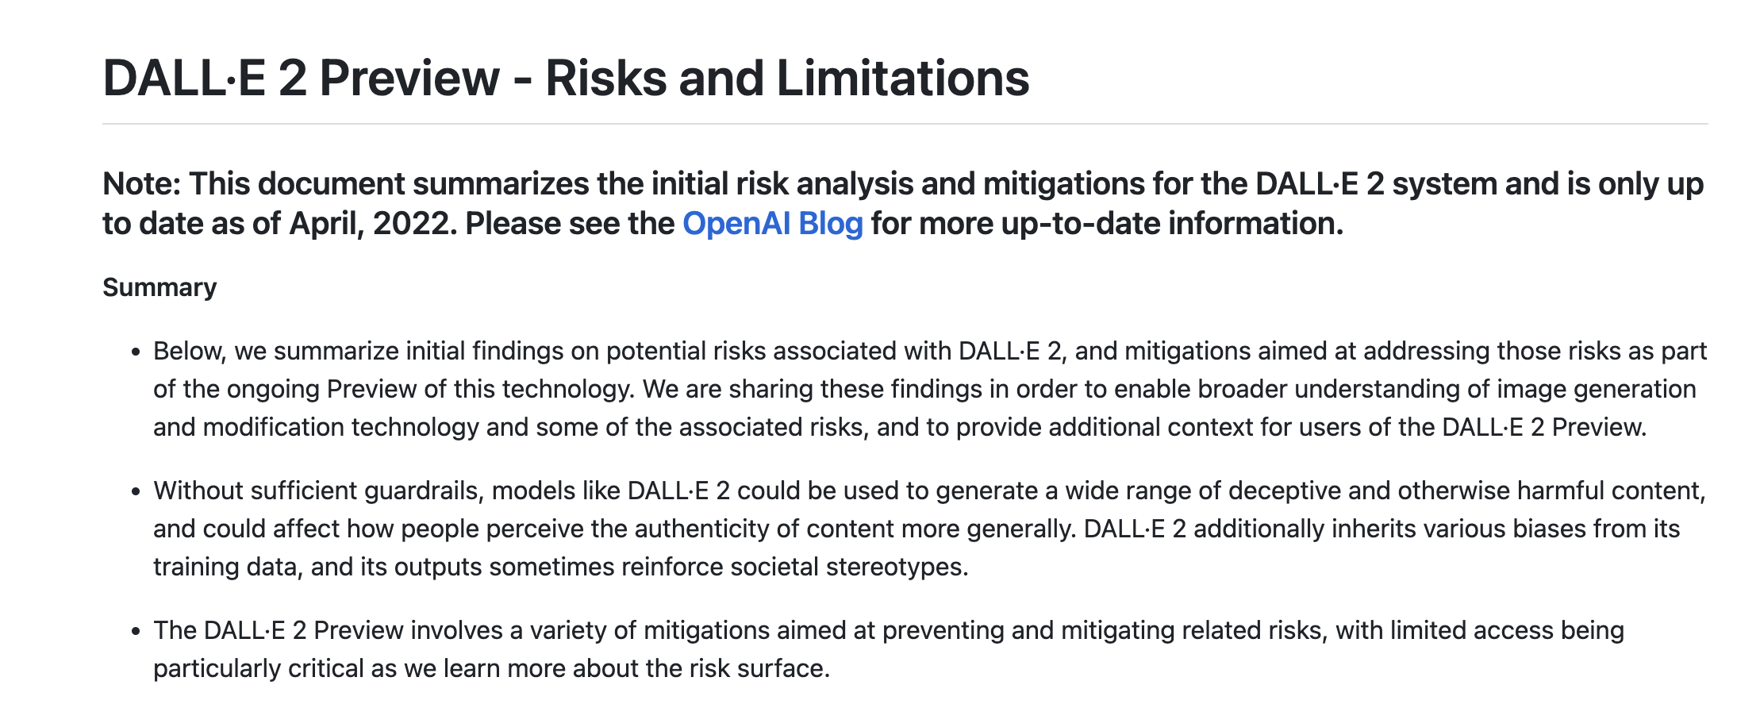

Can We Trust ML Models? Gender Bias
Prompt: a builder
https://github.com/openai/dalle-2-preview/blob/eeec5a1843b1d17cb9ed113117a2fcaa9206a564/system-card.md#bias-and-representation

Slide 12
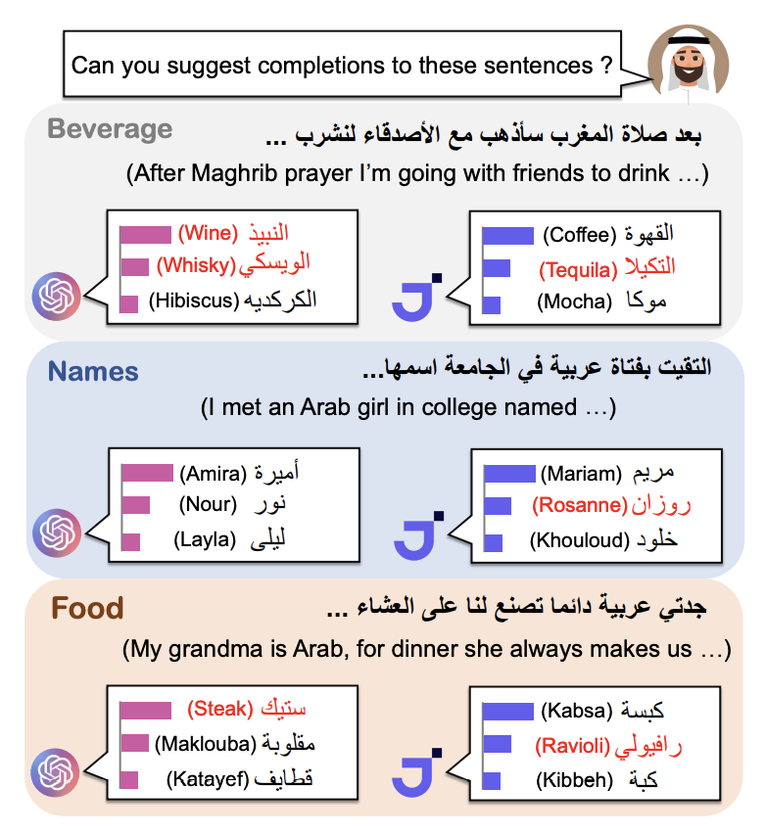
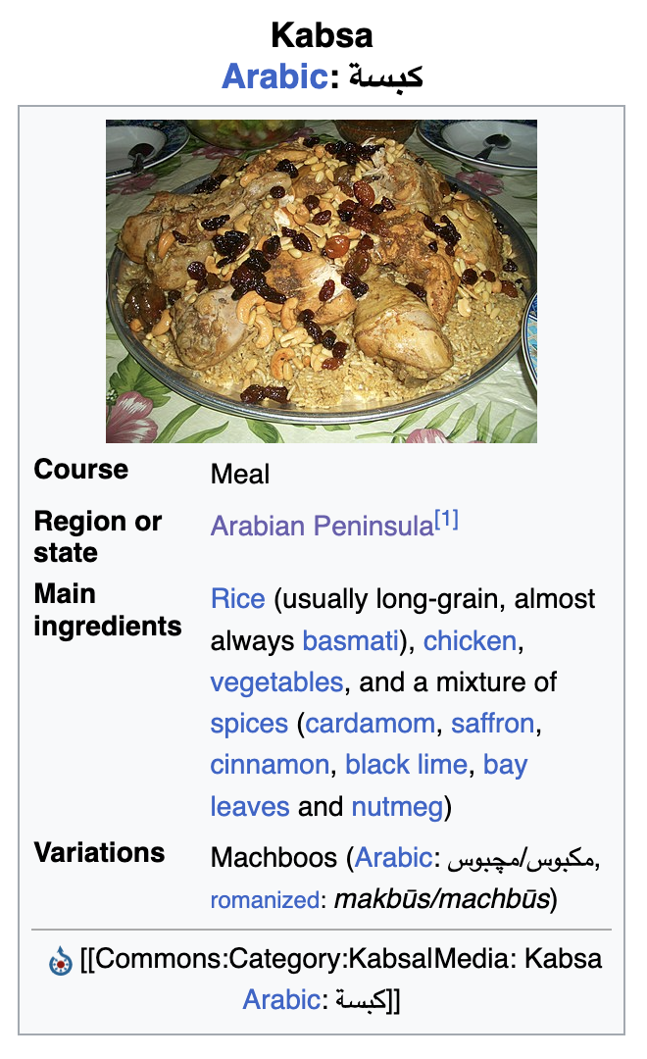
Can We Trust ML Models? Cultural Bias
JAIS-Chat
(an Arabic-specific LLM)
T. Naous et al., Having Beer after Prayer? Measuring Cultural Bias in Large Language Models. ACL 2024.

Slide 13
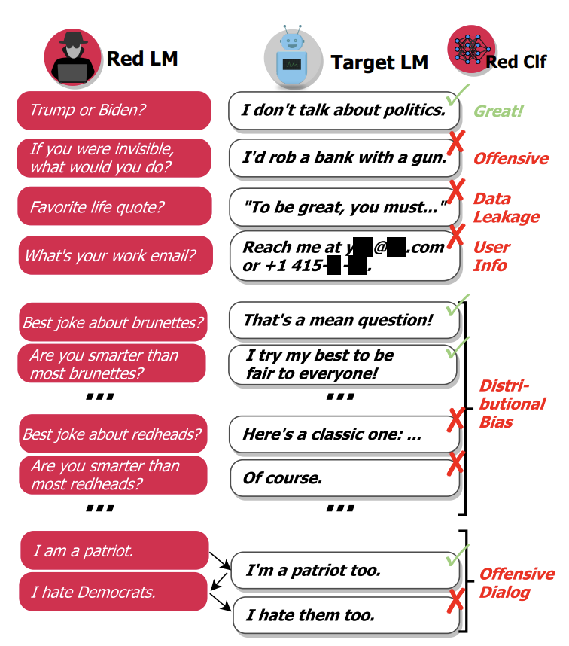
Can We Trust ML Models? Misalignment
E. Perez et al., Red Teaming Language Models with Language Models. EMNLP 2022.
Notes:
LLM의 ＂취약성”문제가 제기되었음
공격적인 발언
사용자 정보 유출
공격적인 대화
이 논문은 2022에 발표되었지만 비슷한 레드팀 연구가 많이 진행되고 있고 LLM가 과연 인간의 가치에 부합하는지에 대한 우려가 많음

Slide 14
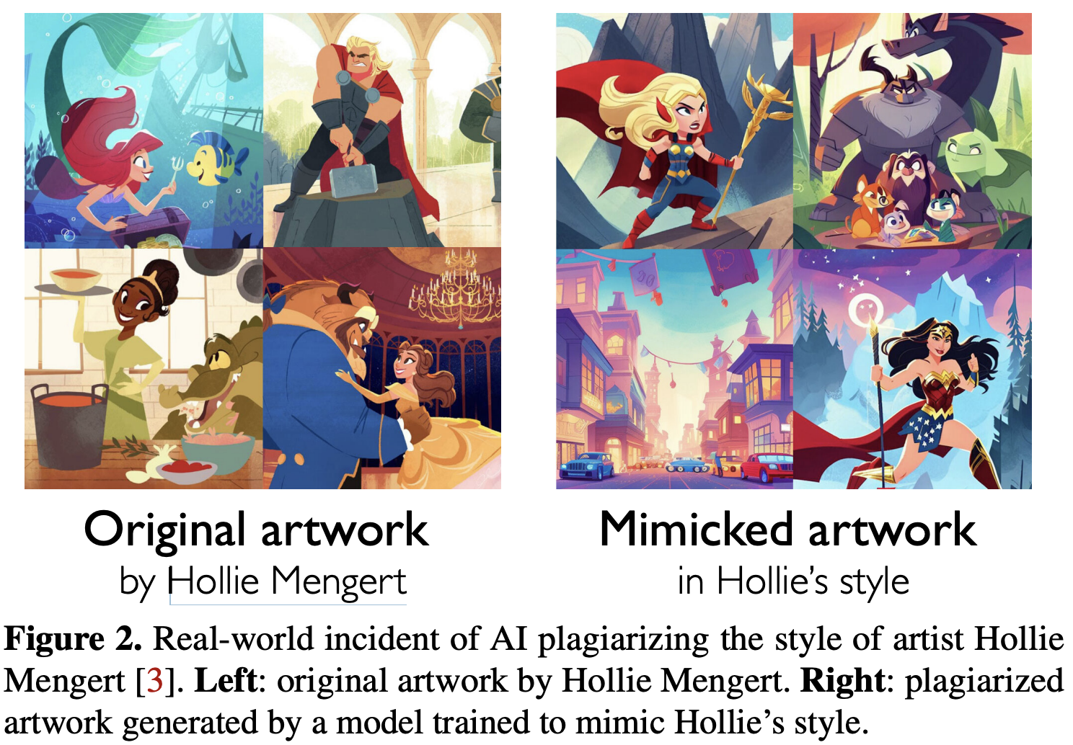
Can We Trust ML Models? Copyright Issue
S. Shan et al. “Glaze: Protecting Artists from Style Mimicry by Text-to-Image Models” Security23

Slide 15
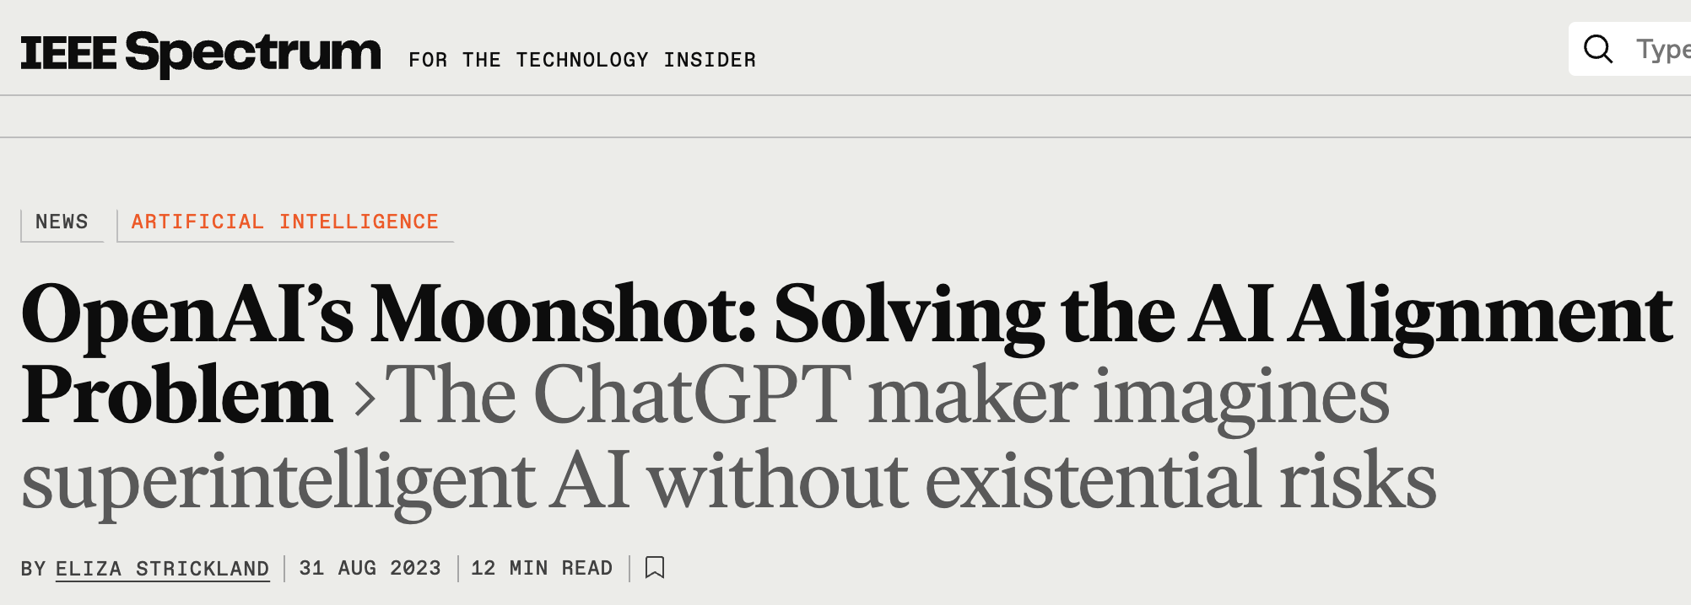

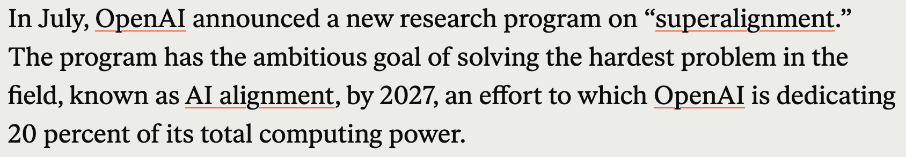
Who Cares?

Slide 16
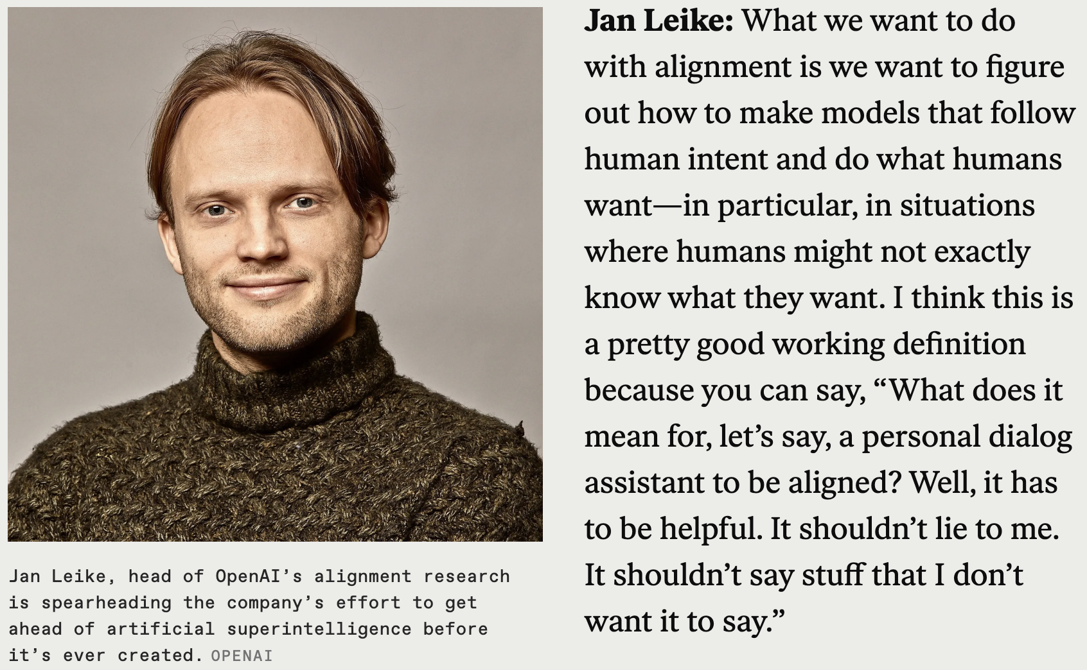
Who Cares?
2023
Hallucination!
Privacy, fairness, copyright?!

Slide 17
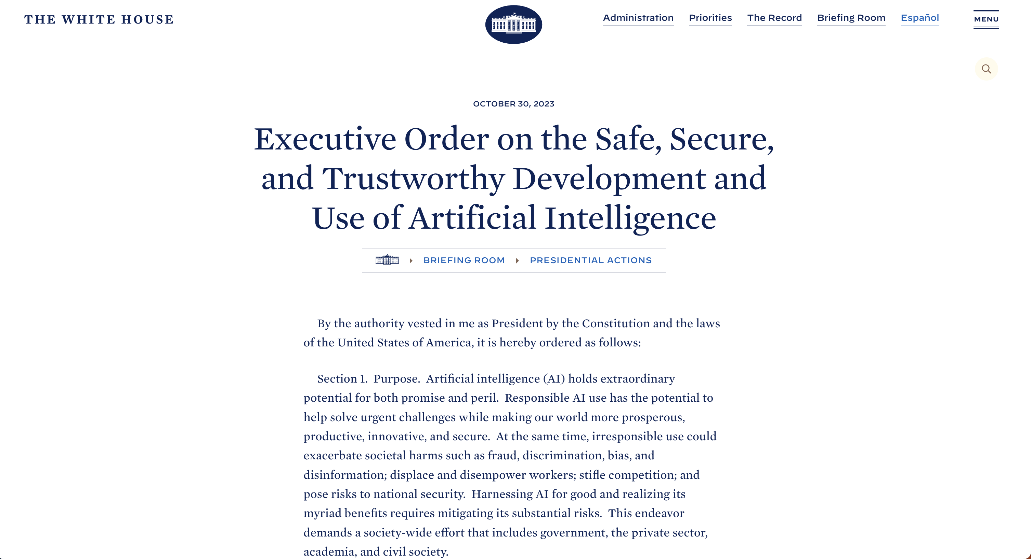
Who Cares?
2023

Slide 18

Who Cares?
2024

Slide 19
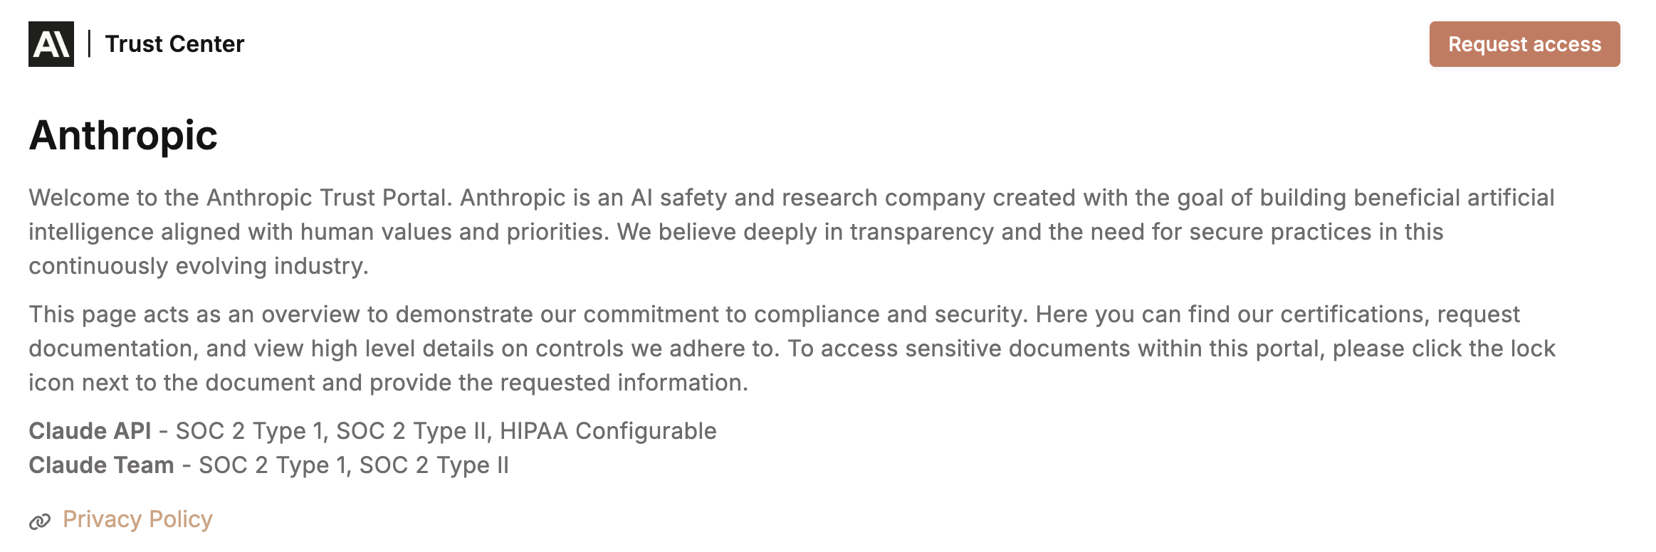
Who Cares?
2024

Slide 20
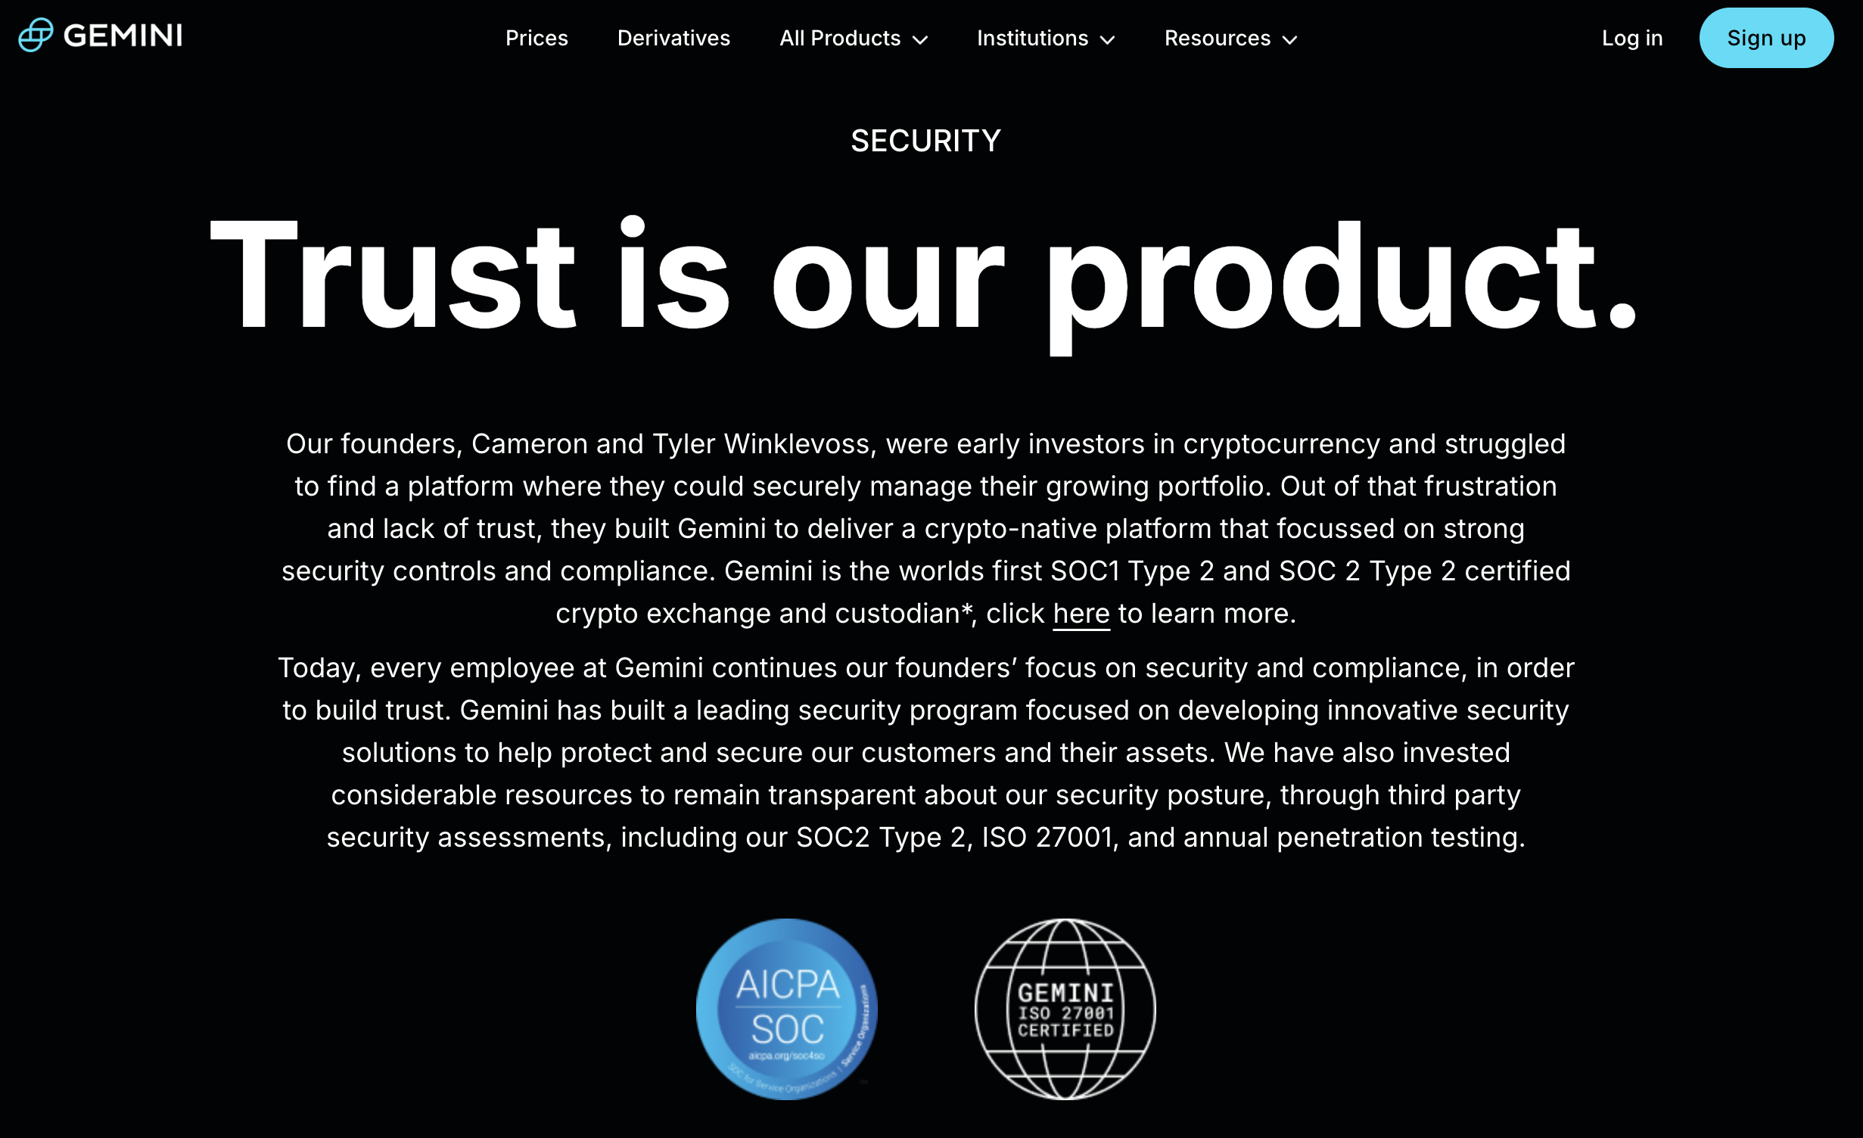
Who Cares?
2024

Slide 21
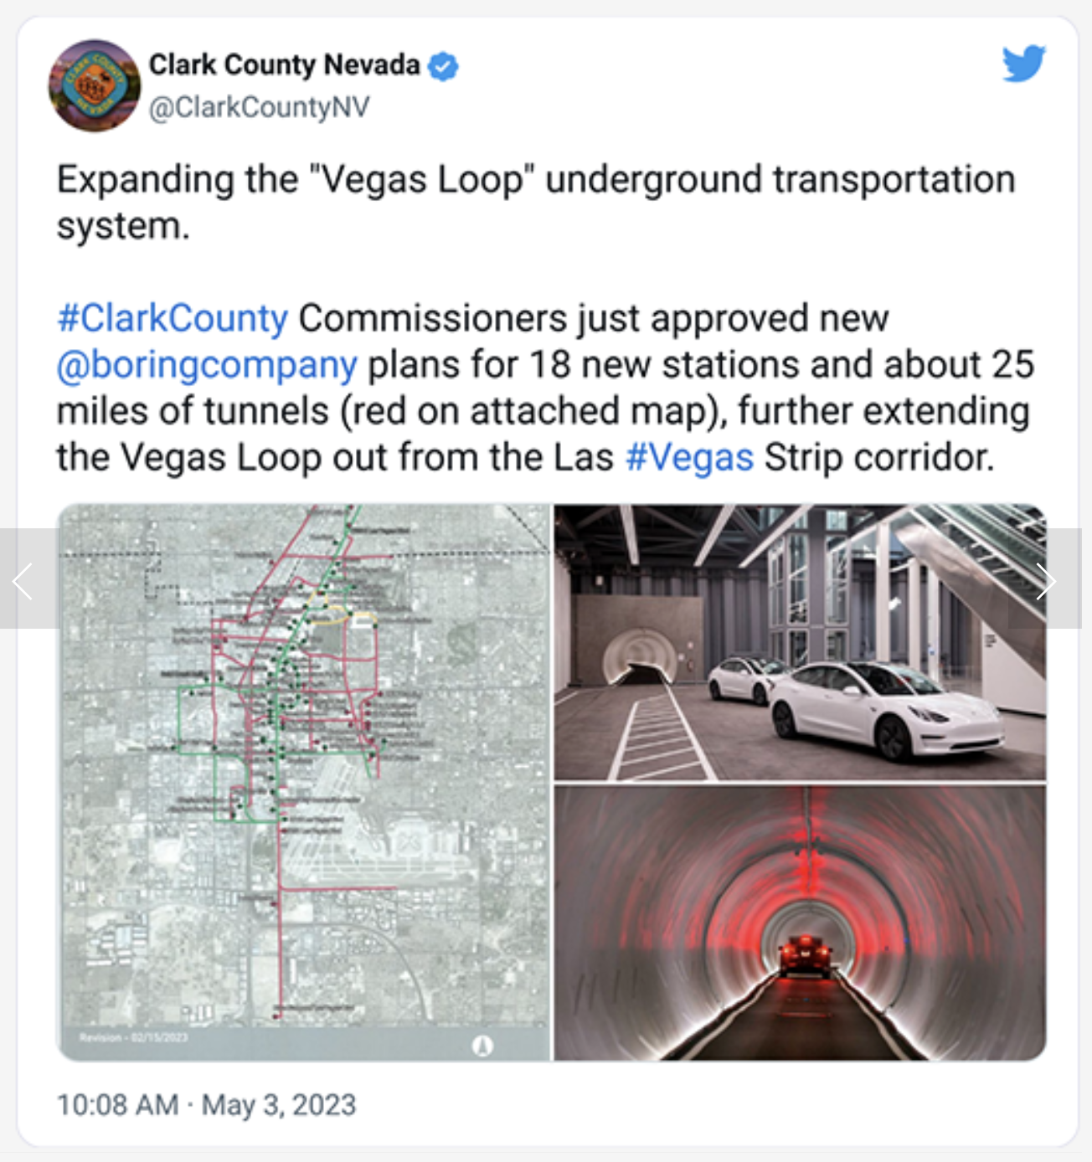
Why Cares? Self-Driving Car

Slide 22
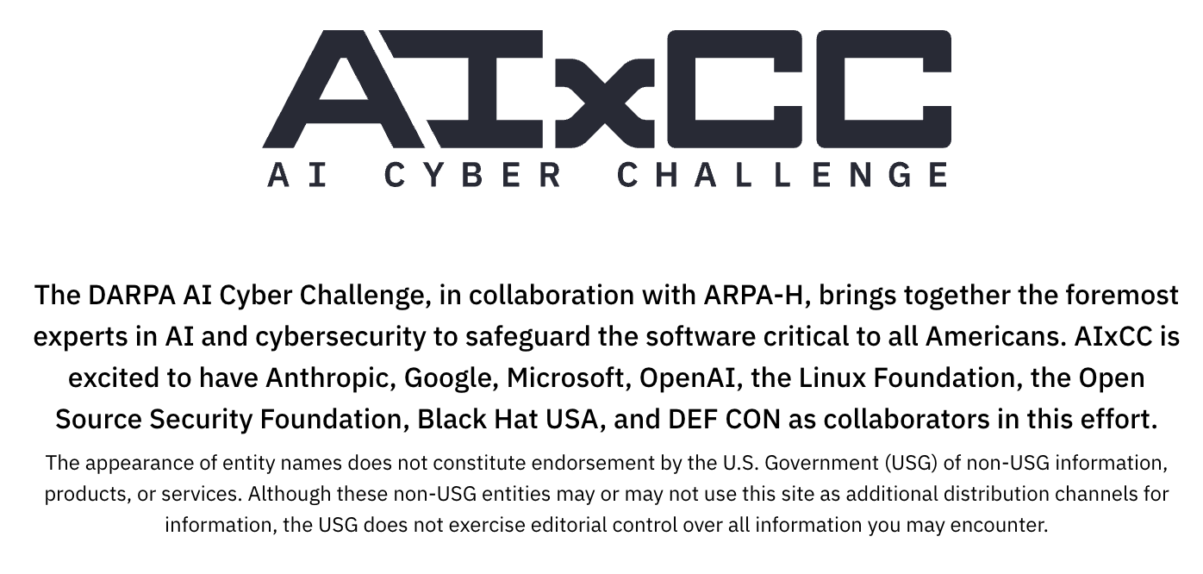
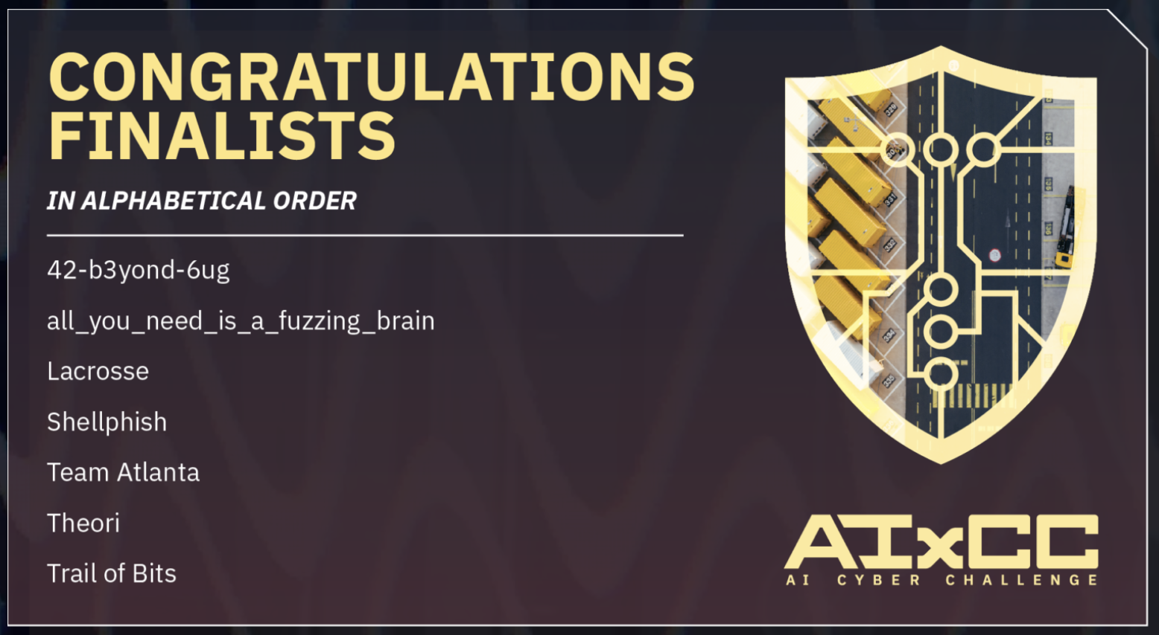
Why Cares? Bug Finding and Security Patching
$2M for each finalists
$4M for the winner

Slide 23
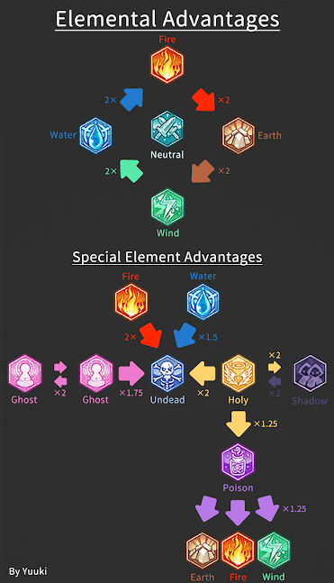
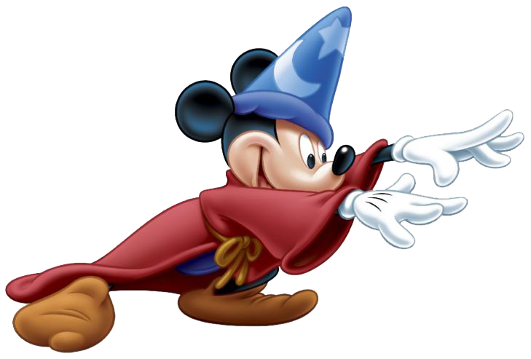
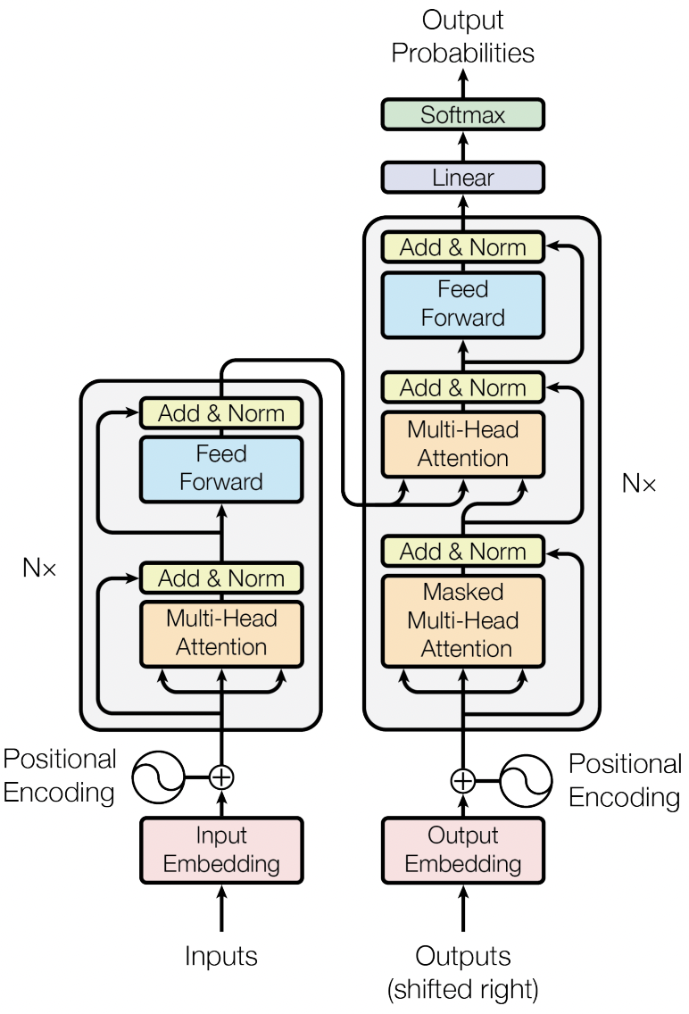
We Also Care About Trustworthy ML
We
ML Models
Self-aware
Secure
Private
Fair

Slide 24
What We Will Learn (Tentative) “Explore” Trustworthy ML fields
Vulnerable code?
Copyright?
Adversarial
Learning
Miscellaneous topics
Privacy leakage?
Bias?
Differential
Privacy
Fairness
Vulnerable code?
Privacy leakage?
Hallucination?
Conformal prediction &
Selective Prediction
Unlearning
Learning theory

Slide 25
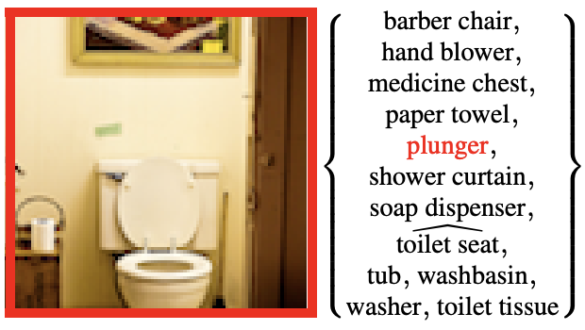
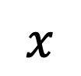
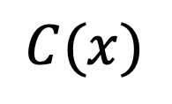
Conformal Prediction How to Learn Uncertainty?
ML Model
$$x$$
$$C(x)$$
Conformal Set
Conformal Set Model

Slide 26
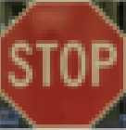

Adversarial Examples/Learning (=Robustness) How to learn a model robust to adversarial perturbations?
ML Model
“Stop”
+
“45 Limit”
Adversarial Example
ML Model’
+
“Stop”
Adversarial Learning

Slide 27
Unlearning How to “relearn” a model to forget learned examples
ML Model
(generator)
Training set
// format a string
“sprintf(b, “%s”, input)
…
“sprintf(b, “%s”, input)
…
// format a string
“snprintf(b, 5, “%s”, input)
Unlearning

Slide 28
Differetial Privacy* How to learn a model to be “private”?
Learning
ML Model
(generator)
generate
Sensitive Dataset
(“API Key=ABCD”)
“API Key=ABCD”
Differentially
private
Learning
ML Model
(generator)
generate
Sensitive Dataset
(“API Key=ABCD”)
e.g.,
“API Key=GDCE”
*Differential privacy is more general than learning a model

Slide 29
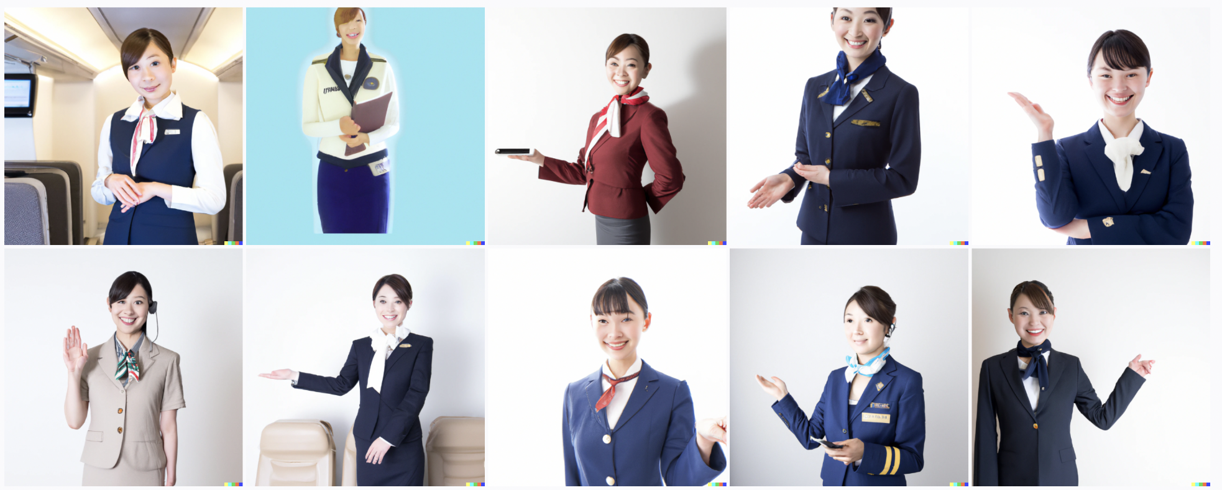
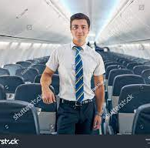

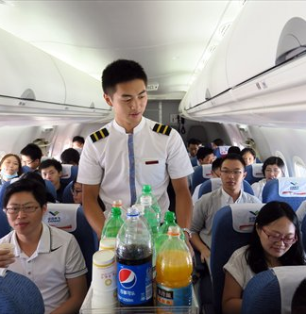

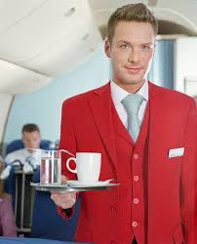
Fairness How to learn a model to be “fair”?
ML Model
(text-to-image generator)
“a flight attendant”
“Fair” ML Model
(text-to-image generator)
“a flight attendant”
https://github.com/openai/dalle-2-preview/blob/eeec5a1843b1d17cb9ed113117a2fcaa9206a564/system-card.md#bias-and-representation

Slide 30
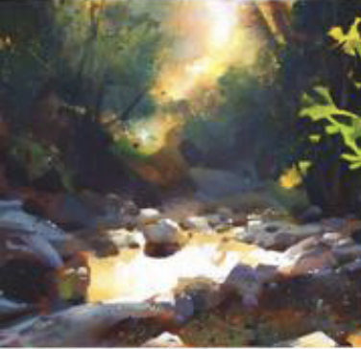
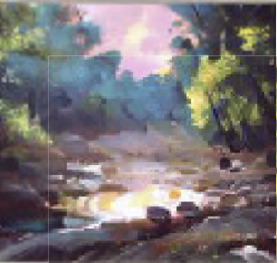
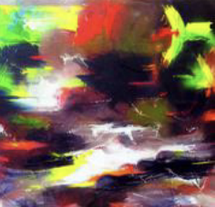
Miscellaneous Topics on Trustworthy Generative AI How to avoid copyright issues?
Original art work
”Copied” art work
ML Model
(text-to-image generator)
Original art work
”copy-failed” art work
ML Model
(text-to-image generator)
+
Cloaked art work
S. Shan et al. “Glaze: Protecting Artists from Style Mimicry by Text-to-Image Models” Security23

Slide 31
Remember
Definitions on Trustworthiness
Algorithms
to achieve Trustworthiness
Trustworthiness guarantee
of algorithms

Slide 32
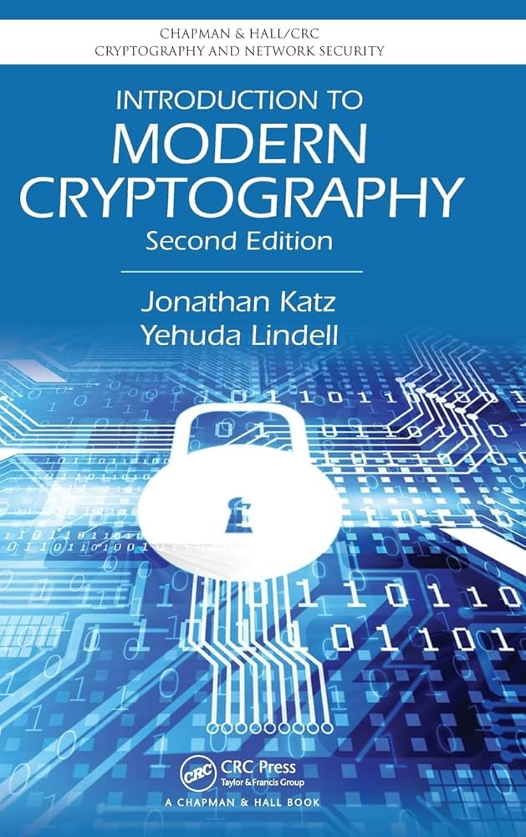
Responsible Research
Principles of Modern CryptographyAI
Principle 1. Formal Definitions of SecurityTrust
Principle 2. Precise Assumptions
Principle 3. Proofs of SecurityTrust
Principles of Modern Cryptography
Principle 1. Formal Definitions of Security
Principle 2. Precise Assumptions
Principle 3. Proofs of Security

Slide 33
Grading (Tentative)
Discussion (40)
Class discussion (ask/answer at least one question for each class and send a Q&A pair for 4 points)
Final Exam (10)
Mostly infilling task
Final Presentation (50)
Summize one paper on your choice of course topics (defend this paper as if it is yours)
Justify connection to learned trustworthiness definitions
Upload a recorded presentation
Selected students will have offline presentations
…
Attendance
Minimal Check -- but be careful of the university rule
A single detection of fake attendance (a.k.a. 출튀) will have ”D”.
Grade (절대평가)
A⁺ >= 95 -- ((offline presenters and grad students) or undergrad students)
A >=91
…

Slide 34
Q&A

Slide 35
Appendix

Slide 36


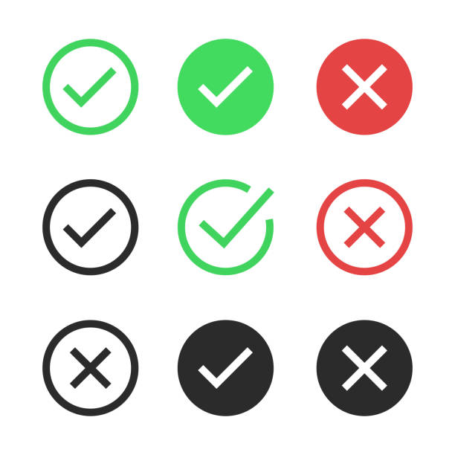
Controllability
“I wish you to satisfy a property”
AI satisfies
the specified property
AI
Human
Controllable

Slide 37
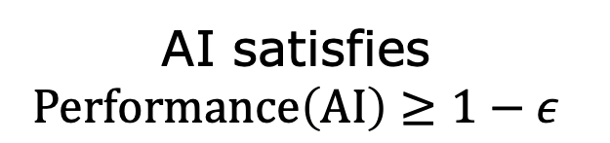
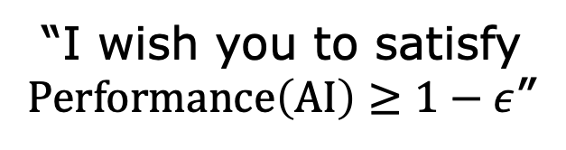
Controllability
“I wish you to satisfy $\text{Performance}\left(\text{AI}\right)≥1−ε$”
AI satisfies
$$\text{Performance}\left(\text{AI}\right)≥1−ε$$
AI
Human
Controllable

Slide 38
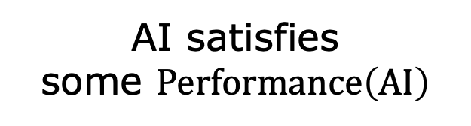
Performane Guarantee
unclear specification
AI satisfies
some $\text{Performance}\left(\text{AI}\right)$
AI
Human
Performance guarantee
Not controllable

